Slide 1

Beyond Hallucinations
A MULTI-AGENT APPROACH TO
FACT-CHECKED AI KNOWLEDGE

Slide 2
Problem Statement
LLMs are powerful but prone to hallucinations and inconsistencies.
Factual correctness and trust in knowledge/news are major concerns.
Can multiple LLMs collaborate to fact-check and refine knowledge more reliably?

Slide 3
Motivation
Single LLMs lack cross-validation and often hallucinate.
Human fact-checking is slow and non-scalable.
Multi-agent frameworks can provide self-consistent, verifiable responses through debate and consensus.

Slide 4
Related Work
LLMs in Fact-Checking (Vykopal et al., 2024): Uses generative models with static datasets.
Multi-Agent Systems (Du et al., 2023; Kim et al., 2024): Debating agents improve accuracy.
Hallucination Mitigation (Tonmoy et al., 2024): Overview of techniques to reduce hallucinations.
Automated Correction (Pan et al., 2024): Categorized into training-time, generation-time, post-hoc.

Slide 5
Methodology: SC-MAKS Framework
Three phases: Generation → Debate → Consensus.
Each agent generates, critiques others, and converges via voting or reward-based consensus.
Consensus computed using weighted agreement across agents.

Slide 6
SC-MAKS Framework
Query
Multiple
LLM Agents
Consensus Module
Debate Phase
Individual Output
Individual Output
Individual Output
Final Output

Slide 7
Justification & Advantages
Redundancy mitigates hallucination through cross-verification.
Debates expose factual errors missed by individual models.
Consensus ensures robustness and reliability.
Inspired by consensus algorithms and adversarial reasoning.

Slide 8
Baselines for Comparison
Single LLM Generation:
No debate or cross-check.
Self-Consistency Decoding
No multi-agent diversity.
RAG-based Models
Retrieval without internal agent verification.
MADR and CausalGPT
Differ in how debates and consensus are structured.

Slide 9
Experiments & Datasets
Datasets
FEVER, TruthfulQA, Fakeddit.
Preprocessing
Clean, balance, and augment data.
Prompt Engineering
Roles, chain-of-thought, adversarial framing.
Fine-Tuning
RLHF with expert-annotated feedback.
Evaluation Metrics
F1, Accuracy, Hallucination Rate, Cross-Agent Agreement.

Slide 10
Experimental design
Datasets
Preprocessing
Prompting
Agent Collaboration
Consensus
Evaluation

Slide 11
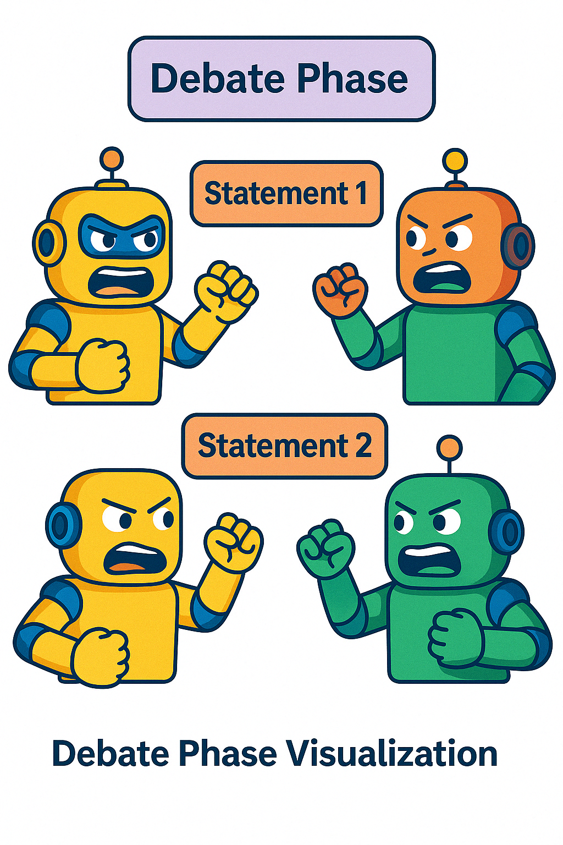

Debate phase

Slide 12
Expected Results
Higher factual consistency and lower hallucination rates than baselines.
Consensus across agents expected to improve robustness and truthfulness.
Performance validated through statistical tests (t-test, Wilcoxon).

Slide 13
Evaluation
Dataset | Task Description | Metrics for Evaluation
FEVER | Claim verification using evidence from Wikipedia. | F1-score, Precision, Recall, Factual Consistency Ratio
TruthfulQA | Evaluating truthfulness of responses to adversarial questions. | Truthfulness Score, Hallucination Rate, Consistency Rate
Fakeddit | Multimodal fake news detection. | Accuracy, F1-score, Precision, Recall, Hallucination Rate

Slide 14
Conclusion
SC-MAKS improves reliability of knowledge synthesis.
Can be applied to high-stakes domains like medicine, law, science.
Provides foundation for collaborative, explainable AI.

Slide 15
Limitations & Future Work
High computational cost of running multiple LLMs.
Shared biases may affect consensus quality.
Future:
Domain-specific agents, parameter-efficient tuning, real-time feedback, multilingual evaluation.

Slide 16

Q & A

